Slide 1

WEBEX
Program Overview for WIC Directors
Notes:
Introduce myself and others in the room.

Slide 2

Objectives of WEBEX
Review important information for directors
Introduce Administrative Manual as a resource
Notes:
Objectives for today’s session.

Slide 3
Agenda
Overview of BPC Program
Administrative Manual
Budget and Fiscal Management
Referrals and Collaboration with Community Partners

Slide 4
Agenda
V. Training
VI. Program Evaluation and Technical Assistance
VII. State WIC Support
VIII. Questions and Answers

Slide 5
Number of BPC programs
Agencies Continuing - 14
Agencies began May 2010- 7
Applications to start Oct., 2010- 21
Applications to start Spring, 2011- 8

Slide 6

Overview
USDA’s Purpose for the Peer Counselor Program:
Responds to the need for a comprehensive peer counseling program
Builds upon the Loving Support Makes Breastfeeding Work campaign
Enhances WIC’s current breastfeeding management and counseling efforts
Notes:
This is based on research from Best Start of successful PC Programs.

Slide 7

Why Peer Counseling Works
PCs serve as role models
Provide women confidence in their ability
Shared backgrounds

Slide 8
FNS “Loving Support” Model Requirements
Adequate Program Support from State and Local Management
Adequate Program Support of Peer Counselors

Slide 9

Characteristics of Successful
BPC Programs in CA
Integrate PCs as part of WIC staff.
Emphasize importance of BPC Program to all WIC staff.

Slide 10

Why Peer Counseling Programs Fail
Absence of defined program goals and objectives;
Discrepancy between the program’s goal and design;
Lack of continuity among personnel and funding;
Insufficient training and support for staff;
Lack of set job responsibilities and expectations for staff; and
Failure to establish external support.
Notes:
Studies indicate these common reasons for failure. Policy 630-10 addresses many of these issues (next slide).

Slide 11

BPC Program Policies and Procedures
Based on WPM 630-10
LAs establish policies and procedures
  Job descriptions, career paths, documentation, monitoring performance, referrals
Notes:
LAs are expected to develop their own policies and procedures based upon WPM 630-10.

Slide 12

WPM 630-10
Revisions in progress
Use current draft

Slide 13

Changes to Breastfeeding Peer Counseling Program Policy
(WIC 630-10)

Slide 14

Overview
Incorporated PC Workgroup comments
Added subheadings
Changed the order

Slide 15
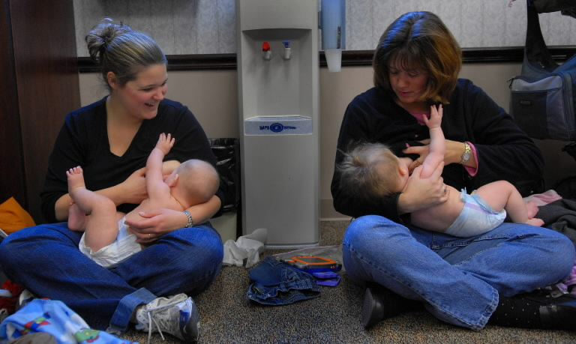
Added
Community Assessment

Slide 16

Allowable Expenses
Policy 630-10
Administrative Manual Appendix
“Allowable Costs for Peer Counseling Funds”

Slide 17

Not Included
PC should have breastfed a child, “preferably”
Agencies wanted to be able purchase the following items:
  Slings for fully BF mothers
  Office supplies
  BF Supplies such as nipple shields, breast shields
  Gift bags after attending BF support group

Slide 18
Administrative Manual
Provides ideas for implementing a BPC program
Job aide
Incorporates suggestions from current BPC programs
Follows policy requirements
Includes Level 3 Best Practices
Notes:
Unless listed in WPM 630-10, the ideas outlined in the manual are not requirements. PC Workgroup suggested content.

Slide 19
Administrative Manual
Table of Contents
I. Introduction
II. Program Overview
III. Program Planning
IV. Budget Development and Fiscal Management
V. Program Development
VI. Positions and Responsibilities
VII. Recruiting and Hiring
VIII. Program Implementation
IX. Supervision, Monitoring, and Support
X. Referrals and Collaboration with Community Partners
XI. Training
XII. Program Monitoring

Slide 20
Administrative Manual
Appendix Contents
Mentoring
Breastfeeding Peer Counselor Budget Template
3. Time Estimates for PC Tasks
4. Allowable Costs for BPC Program Funds
5. BPC Program Quarterly Report 2008 – 2010
6. BPC Program 2008 – 2009 Final Report
7. Memorandum of Understanding
8. Scope of Practice for IBCLC
9. Peer Counselor Scope of Practice
10. Sample MOU with hospital

Slide 21

Budget and Fiscal Management

Slide 22

Consequences of Unspent Funds
Notes:
Again, Sept. 30, 2011 is the deadline for spending grant funds.

Slide 23

Funds disappear!
USDA subtracts funds not spent by Sept. 30th, 2011 from grant next year.
Keep track of how much you are spending for accurate projection on April 30th.

Slide 24
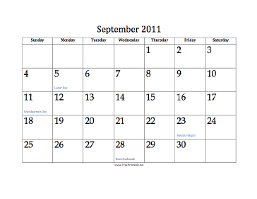

Deadline to Spend Grant:
September 30, 2011
Deadline to liquidate:
Dec. 15, 2011
Notes:
Before we talk about the information contained in the Admin. Manual, need to cover critical piece of information.

Slide 25

Fiscal Management
Reporting Requirements
Quarterly Reports
Due: January, April, July, October
Annual Report
Due: Dec. 15
Notes:
Will send required format to supervisors. Locked after 1st of next qtr. We will track expenditures to ensure agencies are spending.
Quarterly reports due in Jan., April, July, & October. Final Dec. 15.

Slide 26

Fiscal Procedures
Invoice in a timely manner
with Fiscal Expenditure Report
Year-end Time Study reporting (4101)
separate from NSA Breastfeeding Time Study.
(See Contract Management Binder chapter 12)
Notes:
There will be another line added to report. Asha to speak in WEBEX.

Slide 27

Referral and Collaboration with community Partners
Establish a formal referral system:
1. Internal referral system
  Between PC and WIC staff
2. External referral system
  Referrals to WIC
  Referrals from WIC
Notes:
Having a formal referral process is important to both the PC program and regular WIC program. A number of agencies identified lack as a Gap.

Slide 28

Training PCs: Continual
Notes:
Need to continually train PCs. 20 hours not enough. PC Workgroup emphasized this.

Slide 29

Program Evaluation & Technical Assistance
State agency program evaluation and TA visit every other year.
Peer review on alternate years.
Notes:
Peer Assessments were recommended by PC Workgroup. We currently are working on format.

Slide 30

Focus of Monitoring
Evaluate required components from WPM 630-10
Review and analyze challenges, barriers, successes
Notes:
We are updating the forms and will send them to the LA prior to the review.

Slide 31

Areas of Evaluation
Fiscal
Staffing
Caseload
Services
Documentation of Services
Policies
No Worries

Slide 32
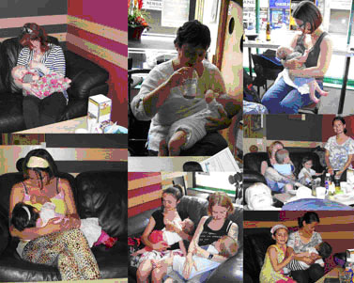
State WIC Support
Mentoring
Training
Notes:
We will tell LAs which mentor they have been paired with soon.

Slide 33

Mentors
Alameda County- Sandi Storch
Community Bridges- Dana Wagner
Monterey- Edie Wiltsee, Janet Vaughan
Riverside- Kathleen Pickering
San Mateo- Anne Garrett
Santa Clara- Kathy Sweeney

Slide 34

Required State Trainings
Overview of Peer Counselor Training- WEBEX
Date: Oct. 5, 2010
2. BPC Program Development and Implementation
Date: September and October, 2010
3. Database Training (PCDB)
Date: September and October, 2010

Slide 35
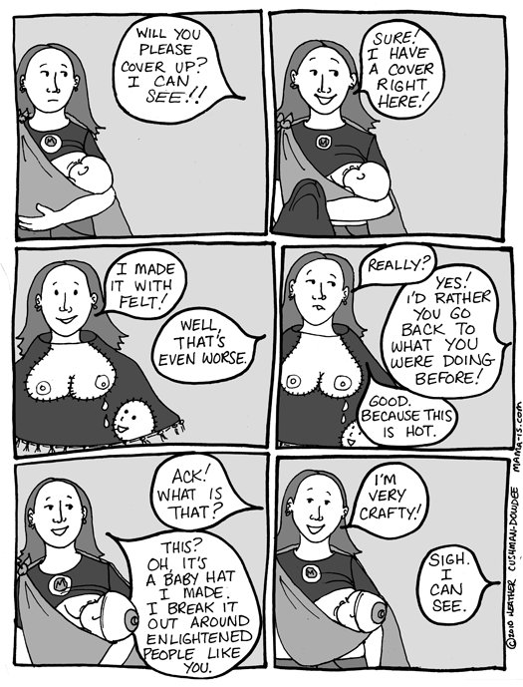
What are your questions?

