Slide 1
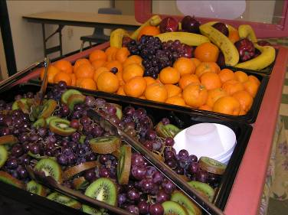

Strong Wellness Policy
Leads the Way
Presented on 6/2/2011 by
Heather Reed, MA, RD
Nutrition Education Consultant
California Department of Education,
Nutrition Services Division
Hreed@cde.ca.gov
5/19/2011
Notes:
“Strong Wellness Policy Leads the Way" Good morning, My name is Heather Reed and I am a nutrition education consultant with the California Department of Education. I will be facilitating today’s webinar which is entitled Strong Wellness Policy Leads the Way.
First we will review some webinar logistics, then I will provide you with an overview of the webinar, then we will launch into the webinar itself.
Note for facilitator as background-
Timing: 60-75 minutes
5 minutes welcome, roll call , overview
5 warm up discussion question posed prior to webinar to transition from workshop to webinar
10- minutes- what is wellness policy,
30 minutes-evaluating the strength of the policy, includes time for activity
20 Opportunities
emerging policy opportunities-nationwide research, 2010 child nutrition reauthorization
strategies for strengthening the policy in your district
5-10 Questions etc

Slide 2
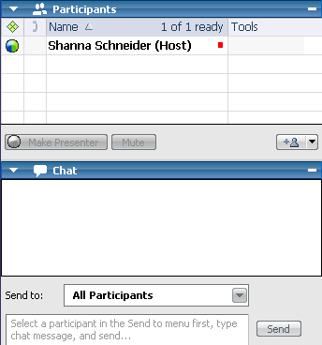
Webinar Logistics
  Everyone’s muted by default
  Please do submit questions!
2
Notes:
2
lets take a look at the control panel. This slide shows an image of the control panel that you should all have on your computer screens. This control panel allows you, our audience, to interact with the panel during the webinar.
Please note that our webinar program mutes everyone by default. Due to the large number of attendees, we will be keeping attendees on mute for most of it , and taking you off of mute at key points. If you’d like to ask a question, please type it into the “Question” box and click the “send” button.
We will answering some questions during the webinar and We’ll also provide our contact information at the end of the presentation so you could contact us directly

Slide 3

Webinar Logistics
Polling questions
  Please select answer and “submit”
Webinar recording & materials will be posted
3
Notes:
3
We want your input! During the webinar we will be asking a few polling questions. Your individual answer won’t be shared with any other participants. The results will be shared instanteously.
The “thumbs up” polling icon will appear on each slide associated with a polling question.
The polling question will appear and we’ll give folks a few second to select and submit their answers.

Slide 4

Overview of Webinar
What’s Required in Wellness Policy?
What Makes A Strong Wellness Policy?
Opportunities and Partners
4
Notes:
Now let’s take a look at the overview for the webinar
We will have three main emphases- what’s required in the wellness policy, what makes a strong wellness policy and finally, opportunities and partnerships to make your policy come alive!
Our training Objectives are by the end of today’s webinar you will have:
Discussed the role of wellness policy and wellness committees in your district’s healthy school environment
Described the required components of Local School Wellness Policy
Practiced evaluating the strength of wellness policy based on the criteria of strength of language, comprehensiveness and specificity
Identifed wellness policy opportunities emerging from Robert Wood Johnson's nationwide research and from the 2010 Child Nutrition Reauthorization Act
Considered strategies to use wellness policy as an opportunity to bolster nutrition education programs

Slide 5
Action Plan
B.
Design Grade-Level Plan and Develop Learning Communities
C.
Develop and Implement Training Plan
D.
Implement Instructional Plan and Provide Technical Assistance
E.
Promote Nutrition Messages; Build School and Community Support
F.
Refine Instructional Plan, Messages, Support
A.
Prepare and Develop Nutrition Instructional Plan
5
Notes:
These topics are part of step A of the action plan reviewed at your training.

Slide 6
Action Plan- Step A:
Prepare and Develop Nutrition Instructional Plan
1. Review School Wellness Policy
Determine the requirements for nutrition education.
Participate in wellness committee meetings.
Assess the nutrition components of the wellness policy and make appropriate recommendations.
Identify key partners.
8:30 a.m. - 10:30 a.m.
6
Notes:
Specifically, we will be focusing step 1 of step A, which is where you begin preparing and developing your nutrittiion instructional plan..
Step one is related to the review of the school wellness policy. The reason is to Use the LSWP to support efforts for teachers to provide quality nutrition education.
Determine if steps can be taken to strengthen the district’s LSWP.
Determine requirements for nutrition education.
Participate in wellness committee meetings to support the wellness implementation plan.
Assess the nutrition education component of the wellness policy and make appropriate recommendations.
Identify key partners supporting local school wellness.
6

Slide 7
Polling Question
Does your wellness policy:
Include nutrition education?
  Yes or No?
Specify at what grades nutrition education is taught?
  Yes or No?
Require a skills based or behavior focus?
  Yes or No?
7
Notes:
Question sent out folks type in
Summarize results and thank them for participating.

Slide 8
What’s Required in Wellness Policy?
8
Notes:
Let’s begin with our first topic today-what’s required in the wellness policy. This will be a brief review of the mandated parts of the policy.

Slide 9

Local School Wellness Policy
Authorized by 2004 Child Nutrition and WIC Reauthorization Act
Required for Districts in 2006
  School Districts participating in the National School Lunch program required to adopt Local Wellness School Policy
9
Notes:
As many of you know, the 004 child nutrition and WIC Reauthorization Act authorized the local school wellness policy. Districts that had national school meal programs, including lunch or breakfast, were required to develop, establish and adopt a wellness policy by 2006. IN Claifonria, about 99% of districts have done this.

Slide 10
Requirements in Wellness Policy
Nutrition Education, Physical Education and Physical Activity Goals
  Other School Based Activities to Promote Wellness
Nutrition Guidelines for Campus
  School Meals
  Competitive Foods and Beverages Sold
Plan for Measuring Implementation
Involvement of Stakeholders in Policy Development- usually a Wellness Committee
10
Notes:
What was required to be in it?
1) Includes goals for nutrition education, physical activity and other school- based activities
that are designed to promote student wellness in a manner that the local educational
agency determines is appropriate;
2) Includes nutrition guidelines selected by the local educational agency for all foods
available on each school campus under the local educational agency during the school
day with the objectives of promoting student health and reducing childhood obesity;
3) Provides an assurance that guidelines for reimbursable school meals shall not be less
restrictive than regulations and guidance issued by the Secretary of Agriculture pursuant
to subsections (a) and (b) of section 10 of the Child Nutrition Act (42 U.S.C. 1779) and
section 9(f)(1) and 17(a) of the Richard B Russell National School Lunch Act (42 U.S.C.
1758(f)(1), 1766(a)0, as those regulations and guidance apply to schools;
4) Establishes a plan for measuring implementation of the local wellness policy, including
designation of 1 or more persons within the local educational agency or at each school, as
appropriate, charged with operational responsibility for ensuring that the school meets the
local wellness policy; and
5) Involves parents, students, and representatives of the school food authority, the school
board, school administrators, and the public in the development of the school wellness
policy.

Slide 11

Basic Sections of a Wellness Policy
Preamble or Overview-(“Whereas…”) sets out philosophy, vision
Links student health to academics
Establishes District commitment to health
11
Notes:
Many professional organizations provided templates that districts used to structure their policies. Most districts had a preamble or overview section that said how important health was to academics and established their comitment to health, some more strongly than others

Slide 12
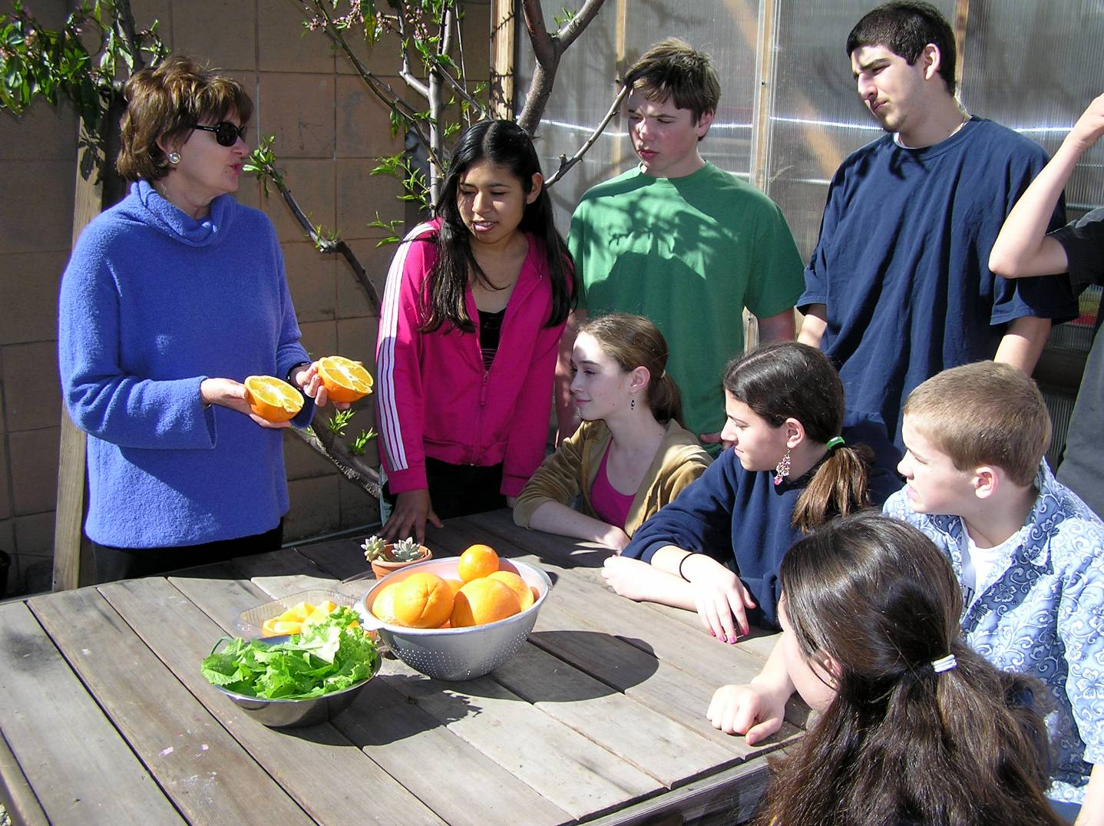
1a. Nutrition Education Goals
Classroom
Cafeteria
Field Trips and After School
Food Marketing
Food Rewards and Punishments
Fundraising and Parties
12
Notes:
Nex t, there needed to be a section that set forth nutrition education goals. Often , this is not one separate section or even if it is, components are covered in other areas as well. Usually, the goals related to the classroom ed, cafeteria and field trips and in some but not many cases, talked about after school. Food marketing, food rewards and punishments and fundraising and parties might also be addressed here.

Slide 13

1b. Other School Based Activities
13
Notes:
Pa and pe
Staff wellness

Slide 14

2. Nutrition Guidelines
School Meals
Ala carte items
Competitive Foods and Beverages
Vending Machines
Atmosphere of Cafeteria
Fundraisers, Rewards, Classroom Celebrations
14
Notes:
The next main area, usually well spelled out are nturiton guidelines.
(read slide)

Slide 15
3. Implementation
Establishes an implementation plan and method for measuring impacts
Ongoing “Wellness Committee” or similar stakeholder group
  Ideally states frequency of meetings
15
Notes:
Implemementation must be referenced . Sometimes the process is spelled out and may refere to an ongoing wellness commmittee

Slide 16
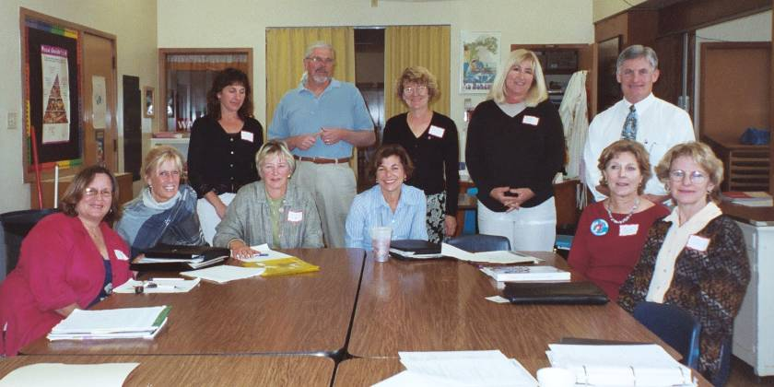
4. Stakeholder Committee
Parents
Students
School Board
Administrators
Food Service Director
Community
Ideally includes all components of Coordinated School Health
16
Notes:
This stakeholder committee was required for the development of the policy.
5) Involves parents, students, and representatives of the school food authority, the school
board, school administrators, and the public in the development of the school wellness
policy.

Slide 17
Polling Question
Does your wellness committee:
Meet regularly (more than quarterly)
  Yes or No?
Include involvement from the following?
  You-Yes or No?
  Food Service Director-Yes or No?
  Physical Education/Activity-Yes or No?
  School Nurses-Yes or No?
  Guidance Counselors-Yes or No?
  Teachers-Yes or No?
  Health Education-Yes or No?
  Parents- Yes or No?
  School Board Members/Administration-Yes or No?
Have a prioritized plan your committee is working on?
  Yes or No?
17
Notes:
Question sent out ahead, have folks type in or call in??
Summarize results and thank them for participating.

Slide 18
What Makes Strong Wellness Policy?
18
Notes:
Our next main topic is what makes a strong wellness policy.

Slide 19
Polling Question
How strong is your “own” wellness policy?
  Strong
  Fair
  Weak
Notes:
Polling question_ how strong is your policy?-summarize results

Slide 20
Strong Wellness Policy…
Comprehensive: All sections included
Language Strength: Requires implementation
  Strong Language: “Shall, must, will, require, comply, enforce”
  Weak Language: “Should, might, encourage, promote, some, try, make an effort”
Specific Subsections: Provides details
  Example: Nutrition Education-number of minutes, grades, standards-based curricula, professional development
20
www.wellsat.org for online policy assessment

Slide 21
Practice
Review your handout with examples of policies (excerpts)
We will rate each one separately and then discuss it before rating the next one
Use your polling panel to rate it
  Strong
  Fair
  Weak
21
Notes:
Now we are going to practice a little. You have a handout that has three policy examples. Spend a few minutes and read through them one at a time. You can use your voting panel to rate it
Strong
Fair
Weak

Slide 22
Polling Question-Example 1:
Central Valley
Factor | Strong | Fair | Weak
Comprehensiveness
Language Strength
Specificity
Notes:
Polling question_ how strong is your policy?-summarize results, asks for volunteer to share rationale

Slide 23
Example 1:Central Valley- Strong, Fair or Weak?
Rate for comprehensiveness, strength of language, specificity: (see handout)
… Shall build a coordinated school health ….
The board shall adopt goals for nutrition education, physical activity, and other school based activities….
The district’s nutrition education and physical education programs shall be based on research… and designed to build the skills and knowledge…
Nutrition education shall be provided as part of the health education program in grades K-12, shall be integrated into other academic subjects….
23
Notes:
Let’s start with example 1. Read through it for a few mintues. Then decide if it is strong fair or weak, depending on our evaluation criteria of comprehensiveness, strength of language, and specificity.
Take a look at your handout for more details. An overview of the policy is presented here.
Comprehensiveness (includes vision, coordinated school health)
Strength of language: shall
Specificity: not specifically how it will be done

Slide 24
Polling Question-Example 2:
Bay Area
Factor | Strong | Fair | Weak
Comprehensiveness
Language Strength
Specificity
Notes:
Polling question_ how strong is your policy?-summarize results ask for volunteer to share rationale

Slide 25
Example 2:Bay Area- Strong, Fair or Weak?
Rate for comprehensiveness, strength of language, specificity: (see handout)
… Believes that an integrated and coordinated school health program will result in school environments….
Must provide health education that is offered at each grade level as part of a sequential, comprehensive, and standards-based program…
Is part of not only health education classes but also classroom instruction…
Includes enjoyable, developmentally-appropriate, culturally relevant…
Includes training for teachers and staff, when necessary
25
Notes:
Again take a look at your handout for example 2. Read the full policy which is highlighted here and rate it again.
Comprehensiveness (includes vision, coordinated school health)
Strength of language: will
Specificity: offered at each grade level, sequential, comprehensive, how it is taught and by whom
Provides training

Slide 26
Polling Question-Example 3:
Sacramento
Factor | Strong | Fair | Weak
Comprehensiveness
Language Strength
Specificity
Notes:
Polling question_ how strong is your policy?-summarize results asks for volunteer to share rationale

Slide 27
Example 3: Sacramento Area- Strong, Fair or Weak?
Rate for comprehensiveness, strength of language, specificity: (see handout)
District is committed to providing school environments that promote and protect health…
…Aims to teach, encourage and support healthy eating by students. School should provide nutrition education…
  is offered at each grade level, part of sequential…
  Includes media literacy
27
Notes:
Comprehensiveness: states overall vision
Strength of language: should
Specificity: offered at each grade level, sequential, comprehensive, how it is taught and by whom but because of “should” is not meaningful

Slide 28
How Do Most Schools Measure Up?
99% of districts nationwide had a wellness policy
Overall policy strength
  33/100 –average policy strength score
Comprehensiveness
  61% included all required components
  20% had evaluation component; 33% had monitoring plan
Specific Subsections
  50% only suggested nutrition education curriculum
  25% included policy against marketing of unhealthy foods
  50% had requirement for ongoing stakeholder council
From Robert Wood Johnson Foundation -Bridging the Gap August 2010 Report: School District Wellness Policies: Evaluating Progress and Potential for Improving Children's Health Three Years After the Federal Mandate
http://www.bridgingthegapresearch.org/research/district_wellness_policies/
28
Notes:
Now lets look at how districts rated nationwide, according to the Robert Wood Johnson Foundation’s report-bridging the gap.

Slide 29
Opportunities
…. And Partners
29
Notes:
Now that we have talked about what’s required in a policy and how to rate it, let’s talk about opportunties and partnerships to make our policies better-both in words and implementation

Slide 30
Policy Opportunities
Nutrition Education Program- Core Component of Comprehensive Health Education
Devoted Staff and Resources for Wellness Policy Implementation and Evaluation
Food Marketing and Advertising, Vending Contracts
School Meals- Nutrition Quality
Other areas that support nutrition education
Physical Activity- Defined In School
Physical Education taught by Trained PE Educators
Joint Use Agreements and Safe Routes
30
Notes:
Some big picture Policy opportunities for all districts were identified by Robert Wood Johnson, based on their survey results and research that specifically target nutrition education are nutrition education program, devoted staff and resources, food marketing, and school meals.
Nutrition ed should be a core component of a comprehensive health education program or a stand alone program.
Next to make sure the wellness policy is implemented, monitored and evaluated, devoted staff and resources are essential.Ideally, a wellness coordinator would oversee the district with liaisons at each school site. Minimally, a committee is needed.
Next, food marketing needs to be improved to promote healthy choices and not advertise less healthy products prominently. This should extend to the vending contracts.
Finally, their recommendations include improving the quality of school meals, such as more fresh produce, etc.
Some other areas that support nutrition education

Slide 31
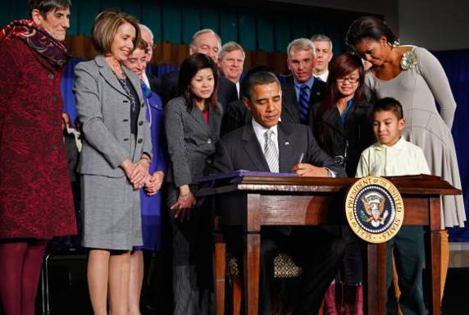
Changes in the 2010
Child Nutrition Reauthorization
Major enhancements to school meal pattern
Strengthening of wellness policy
  Transparency- Inform and update public about implementation
  Stakeholder participation -Development, implementation, and review and update of local school wellness policy
  Monitoring- Periodically measure and assess compliance and progress on wellness policy
31
Notes:
Another policy opportunity on a global level will happen as a result of changes to the 2010 child nutrition reauthorization act, also known as the 2010 Healthy Hunger Free Kids act. This act put sforth ome major changes that support nutrition education including major enhancements of the school meal pattern that include more fresh fruits and vegetables, lower fat milk, sodium, fat. There is also a strengthening of the wellness policy in terms of stakeholder participation, transparency, and monitoring.
Let’s start with a poll about transparency then we will return to this slide.
Read slide…

Slide 32
Polling Question
32
How transparent is your wellness policy? Is it:
Easy to locate?
  Yes or No?
Reported to the School Board annually?
  Yes or No?
Communicated to parents and other stakeholders in a variety of ways?
  Yes or No?
Notes:
Summarize results and thank them for participating.

Slide 33
Changes in the 2010
Child Nutrition Reauthorization
33
Major enhancements to school meal pattern
Strengthening of wellness policy
  Transparency- Inform and update public about implementation
  Stakeholder participation -Development, implementation, and review and update of local school wellness policy
  Monitoring- Periodically measure and assess compliance and progress on wellness policy
Notes:
Read through stakeholder participation and monitoring
You can lead changes in your district by letting key people know about the changes that are coming . Share with them where your policy is now and the gap, if appropriate, to where they will be required to be in the near future.
Read slide…

Slide 34

When It Works Best…
  Strong Commitment
  Vision
  Time
  Attention to Needs
  Ongoing Investment
34
Notes:
To make changes in your policy and your nutrition education program- you need a working and enthusiastic team!
Strong commitment & buy-in from various sectors
P.E., Food Service, parents, teachers, students, Principals, district administrators…
- Vision - clear ideas of goals and motivation
- Time to think, plan, develop the language
- Attention to needs of YOUR school district, its population, culture, location…
Tweaking the “template” to fit your profile
Ongoing investment in making it work

Slide 35
Strengthening Policy in Your District
Build a team!
Who can help you?
  Think back to chart from networking activity
Shared responsibility with your partners
  Decision makers
  Allies
  Role Models
35
Notes:
So where does the team come from? Maybe you already have one…. But if you don’t you can find supporters. Think back to the chart you had from your networking activity. Who can help you?
And what role can they play with shared responsibility?
Some are your decision makers, some allies, some role models or general supporters.

Slide 36
Champion Letters-Summary
Highlights of the results

Slide 37
How to Get Started
Review policy and implementation as a team:
If policy is strong and implementation weak
  Point out gaps, Select one focus area to improve
If implementation is strong but policy is weak
  Showcase successes and identify how to update policy
If both are weak…
  Select one focus area to improve, possibly in one school
  Publicize impact
  Then work to enhance policy
If both are strong …
  Celebrate and promote
37
Notes:
How can you get started? That may depend on where your district is currently in terms of policy and implementation. Its helpful to do the policy review process first, and do it as a team so that you get buy in and commitment to proposing changes.

Slide 38
Summary: Strong Wellness Policy Leads the Way
Discussed major components of wellness policy, activities of wellness committees
Rated your policy and practiced with examples
Explored strategies for strengthening the nutrition education component

Slide 39
Training Opportunity!-Join Us
Nutrition Education That Works!
2011 Childhood Obesity pre-conference session on June 28, from 8:30 AM- 11:45 AM
Learn how to choose the right nutrition education curriculum for your students, using the Nutrition Education Resource Guide
  Features the 2010 Nutrition Competencies

Slide 40
Questions
Heather Reed at hreed@cde.ca.gov
Thank You !
40

