Slide 1

California Department of Public Health
California Women, Infants, and Children (WIC) Program
Vendor Certification Program

Slide 2
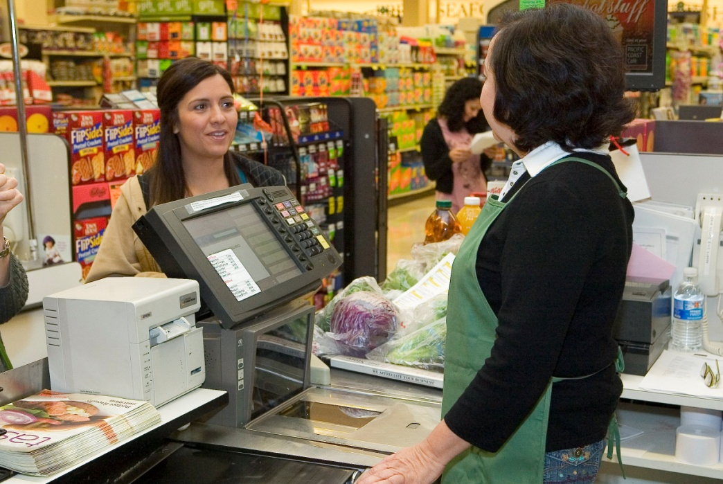
Icebreaker
What are the benefits of being a WIC vendor?

Slide 3




Some basics…..
Purpose of WIC
WIC Goals

Slide 4

Discussion Question
What kinds of WIC families come to your store?

Slide 5
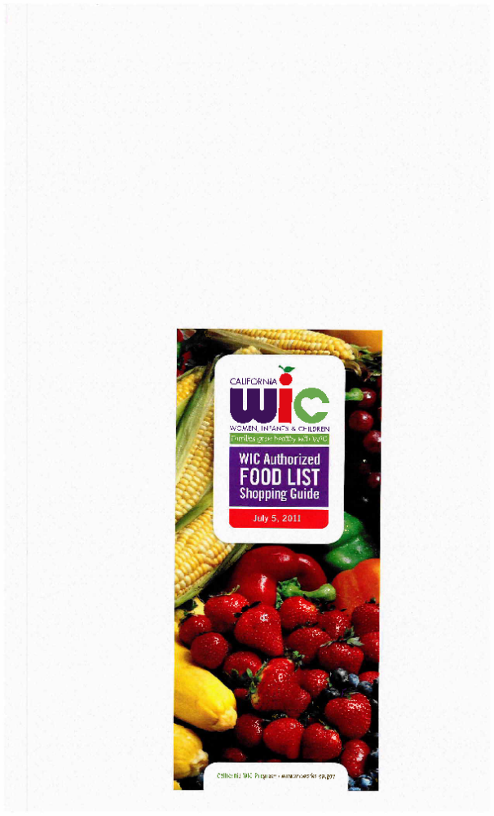



WIC Authorized Food List Shopping Guide
The “WAFL” Guide!

Slide 6
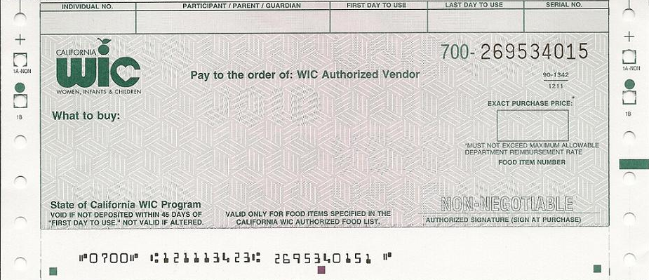
Elements of the WIC Food Instrument*
042913508SG
SELENA BARQUET
JUL 10 11
AUG 08 11
269534015
FOOD ITEM NUMBER: 6012
1 (GALLON) AND 1 (QUART) MILK, LOWER FAT
1 DOZEN EGGS
1 (16 OZ) CHEESE
1 (16 OZ) DRY BEANS, PEAS, OR LENTILS
OR 1 (16-18 OZ) PEANUT BUTTER
USE JULY 5, 2011 WAFL SHOPPING GUIDE
6012
*Also known as WIC Check

Slide 7
FRUITS AND VEGETABLES FI
701925317MS
MADRID SPAIN
JUL 10 11
AUG 08 11
269534015
FOOD ITEM NUMBER: 2006
USE JULY 5, 2011 WAFL SHOPPING GUIDE
$8 (EIGHT DOLLARS) FRUITS AND VEGETABLES
MAY COMBINE FRESH, DRIED FRUITS, FROZEN, AND CANNED
PARTICIPANT MAY PAY AMOUNT OVER $8 (EIGHT DOLLARS) 2006

Slide 8
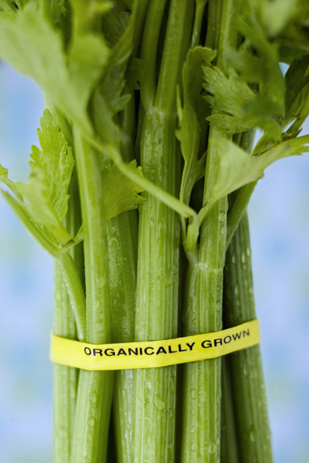
Fruits and Vegetables FI
Amount of the WIC FIs:
  $ 3
  $ 4
  $ 6
  $ 7
  $ 8
  $ 10

Slide 9

The WIC FI Transaction

Slide 10

SCENARIO
A WIC shopper comes to the register to purchase this hot breakfast cereal.
Can the WIC shopper just purchase the 28 oz. box of cereal or does the WIC shopper have to purchase the full 36 oz. stated on the WIC FI?
Cream of Wheat
28 oz size

Slide 11
SCENARIO
Mike, a WIC shopper, is at your cash
register. He mentions that he found all the
items listed on the WIC FI except for one (1)
quart of lower fat milk. Mike wants to
know if you have it available.
What would you do if you don’t have the item
available?

Slide 12
SCENARIO
A WIC shopper has a Fruits and Vegetables FI with the denomination of $6.00 and her purchase total is $6.50.
What options does the WIC shopper have to complete the WIC FI transaction?

Slide 13
SCENARIO
A WIC shopper has a Fruits and Vegetables FI with the denomination of $8.00 and the purchase total is $7.50.
Can the cashier give the WIC shopper the remaining
monies that’s left on the WIC FI?

Slide 14
Infant Formula Food Instrument
JUL 10 11
AUG 08 11
269534015
231900713JD
LISA DOE
FOOD ITEM NUMBER: 1049
USE JULY 5, 2011 WAFL SHOPPING GUIDE
2 (12 oz.) INFANT FORMULA
ENFAMIL GENTLEASE POWDER ONLY
MUST BUY FULL QUANTITY
1049

Slide 15



How the Maximum Department Reimbursement rate for WIC FIs is set:
Peer Groups
Peer Groups are based on three characteristics of your
store:
Store Type
Geography
Number of Registers

Slide 16
Vendor Peer Group Exercise
To determine the Peer Group Number of your store, follow the instructions in the upper yellow box on page 14.

Slide 17
Maximum Allowable Department Reimbursement Rate
“MADR”

Slide 18
Depositing your WIC FIs
1. Endorse the WIC FIs one of the following ways:
      Written Signature
      Store Stamp, or
      Cash Register Stamp

Slide 19
Depositing your WIC FIs
  2. Submit the WIC FI Serial Numbers.
  There are three methods of submission:
    Telephone
    Internet
    Electronic file submission
  3. Check the status of your submission.

Slide 20
Depositing your WIC FIs
4. Ensure successful payment by checking the following:
      Dates on the WIC FIs,
      WIC FI MADR
      Serial numbers
  Regarding the serial numbers……

Slide 21
The serial numbers must match!
042913508SG
SELENA BARQUET
JUL 10 11
AUG 08 11
269534015
FOOD ITEM NUMBER: 6012
USE JULY 5, 2011 WAFL SHOPPING GUIDE
1 (GALLON) AND 1 (QUART) MILK, LOWER FAT
1 DOZEN EGGS
1 (16 OZ) CHEESE
1 (16 OZ) DRY BEANS, PEAS, OR LENTILS
OR 1 (16-18 OZ) PEANUT BUTTER
6012
If the serial numbers do not match on a WIC FI, how do you process the WIC FI differently to prevent it from being rejected for payment?

Slide 22
5. Deposit the WIC FIs into your financial institution:
Wait 24 hours after submitting your serial numbers to deposit.
Deposit no later than 45 days from the “first day to use” on the WIC FI.

Slide 23
Preventing Rejected WIC FIs
Turn to page 18 of your VCP Workbook and complete the puzzle.
Hint: Each selection is used only once.

Slide 24
Practice Test

Slide 25
Additional Requirements
Purchasing Infant Formula from Approved Manufacturers
Stocking Requirements
Inventory Records
Use of the WIC Logo and Acronym

Slide 26

Unauthorized use of the WIC logo and acronym.

Slide 27
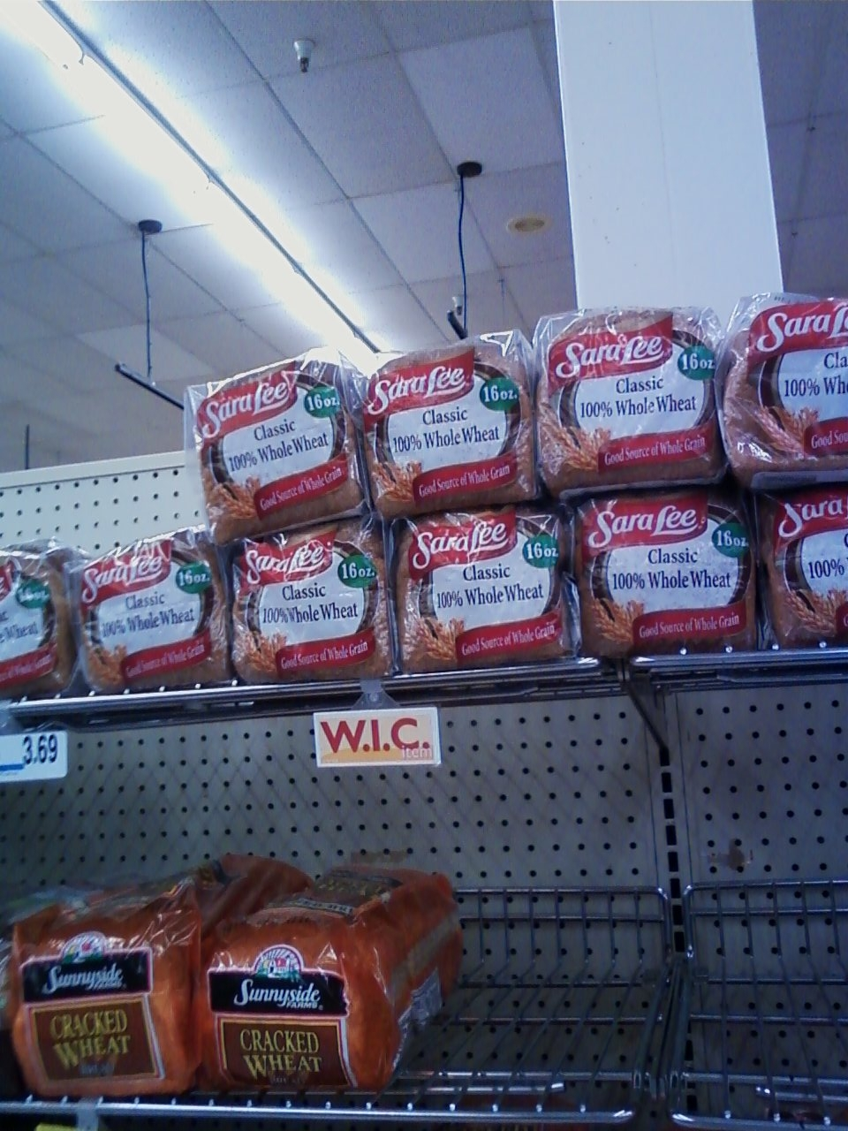

Slide 28
Additional Requirements
Purchasing Infant Formula from Approved Manufacturers
Stocking Requirements
Inventory Records
Use of the WIC Logo
Notification of Changes in your Business
Staff Training

Slide 29

Training your Staff Activity
At your table discuss
what WIC topics you
are planning for your
staff trainings.

Slide 30
Monitoring
Monitoring is conducted in the following
ways:
  Pre-authorization on-site visits
  Compliance buys
  On-site routine monitoring visits
  Audits

Slide 31
Sanctions
Disqualification from the CA WIC Program
Money penalties
Claims
Filing an appeal

Slide 32

WIC and the Food Stamp Program
Now called
California WIC and the CalFresh Program notify each other of program violations.

Slide 33
Additional Resources
WIC Program Website

Slide 34
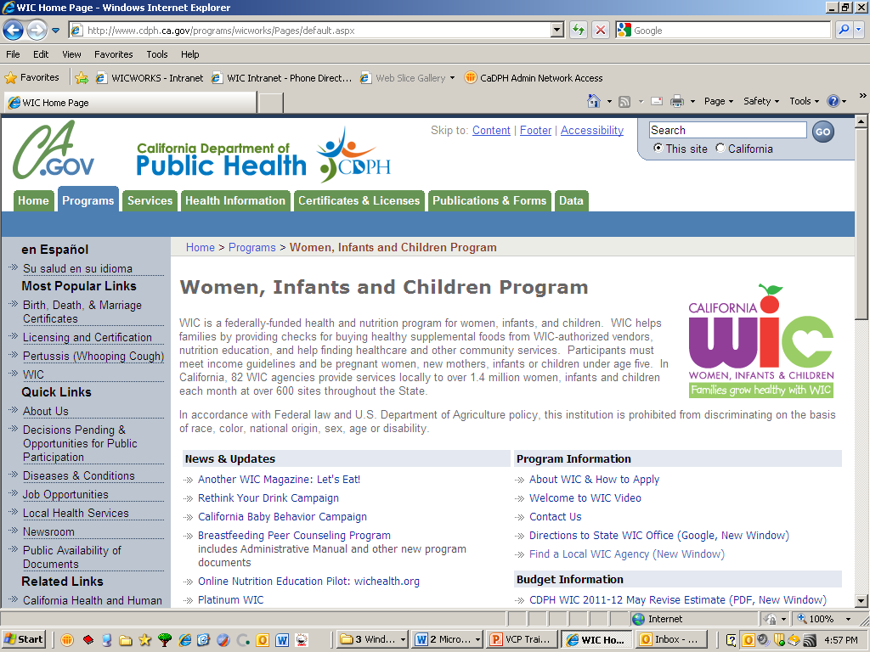
www.wicworks.ca.gov

Slide 35
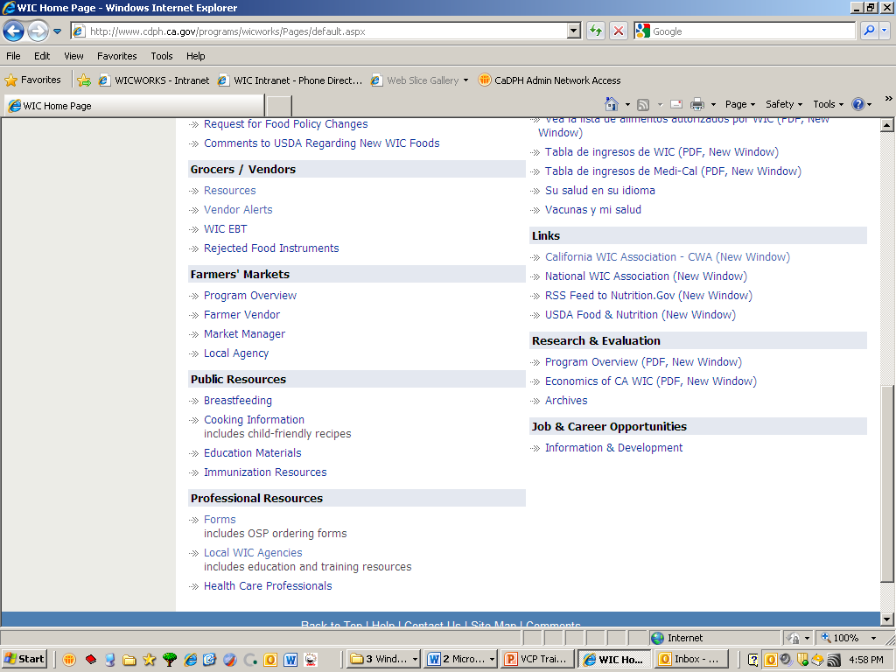
Scrolling down….
Click here!

Slide 36
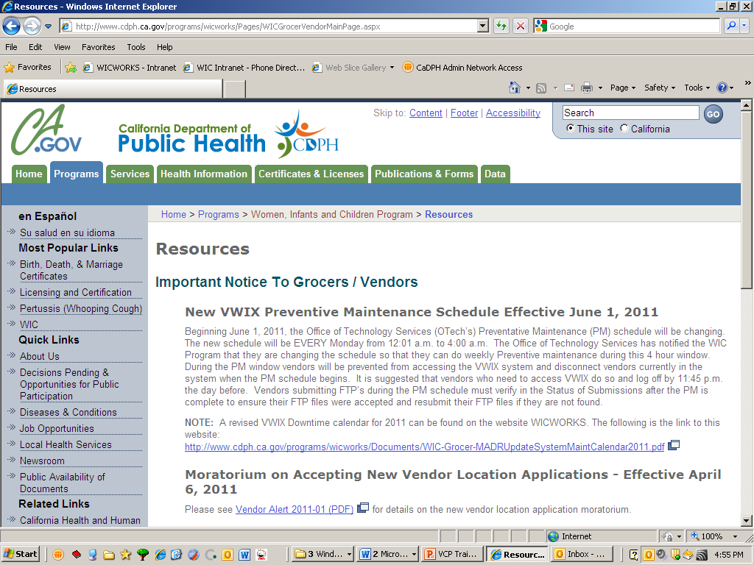
WIC Vendors Webpage

Slide 37
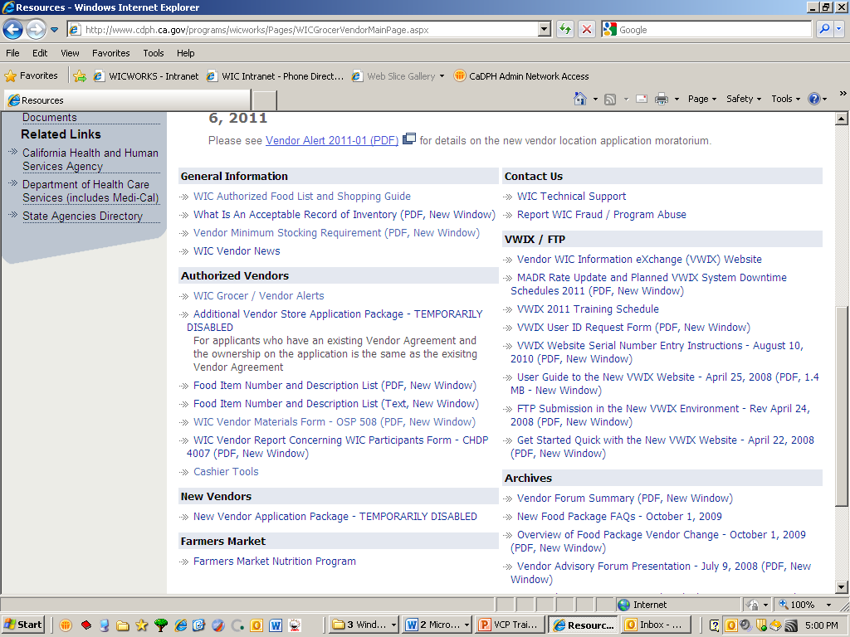
Scrolling down…

Slide 38
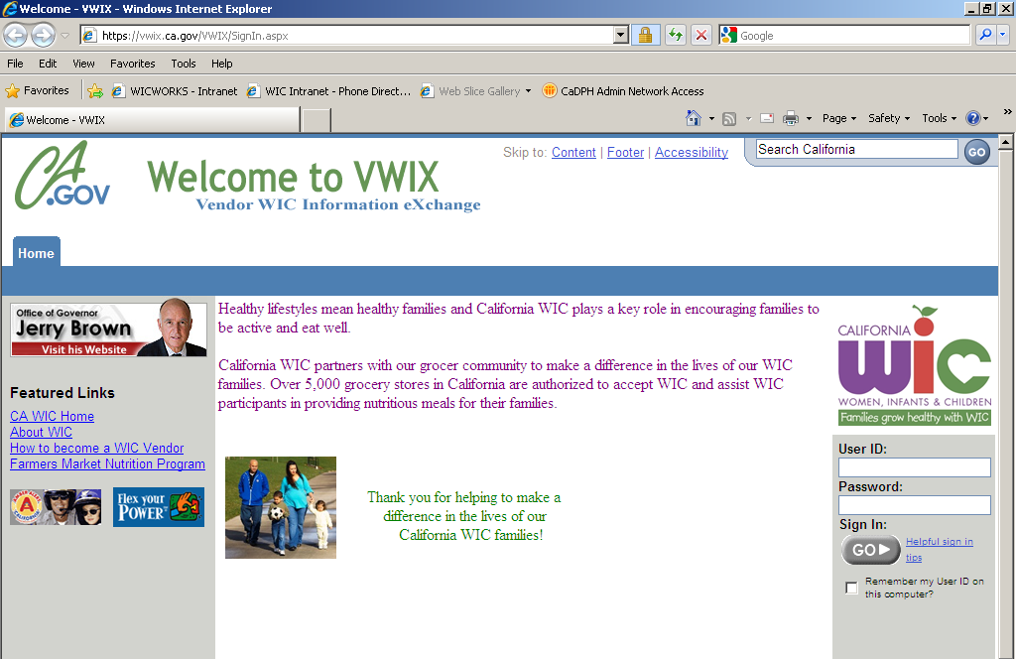
https://VWIX.ca.gov

Slide 39
Additional Resources
WIC Program Website
Newsletter
Vendor Complaint Process

Slide 40
Additional Resources
WIC Program Website
Newsletter
Vendor Complaint Process
CA WIC Vendor Consultants
Local Vendor Liaisons (LVL)

Slide 41
Test and Evaluation
Thank you!

